Slide 1
Minimum Edit Distance

Slide 2
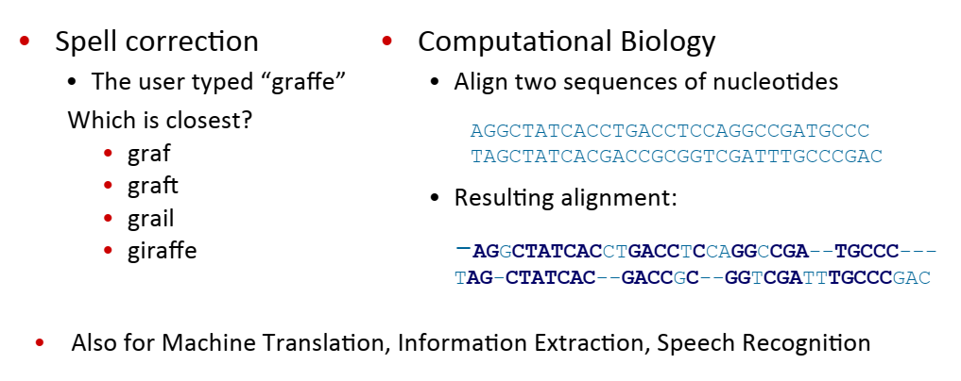
How similar are two strings?

Slide 3
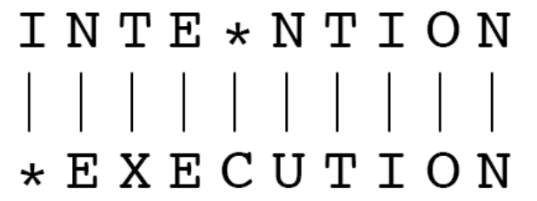
Edit Distance
The minimum edit distance between two strings is
the minimum number of edits
Insertion
Deletion
Substitution
needed to transform one to other.
Two strings and their alignment

Slide 4
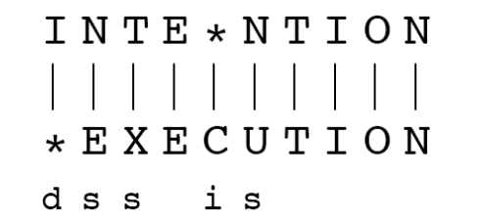
Minimum edit distance
If each operation has cost of 1 • Distance between these is 5 If substitutions cost is 2 (Levenshtein) • Distance between them is 8

Slide 5
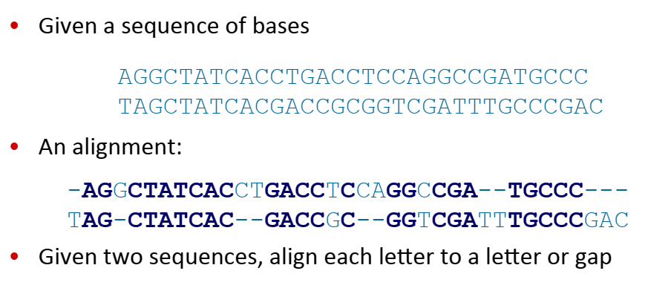
MED app1: Alignment in Computational Biology

Slide 6
MED app2: In NLP
Evaluating Machine Translation and speech recognition R Spokesman confirms senior government adviser was shot! H Spokesman said the senior adviser was shot dead! S I D I
Named Entity Extraction and Entity Coreference

Slide 7
MED computation
For two strings • X of length n • Y of length m
D(i, j): the edit distance between X[1..i] and Y[1..j]
X[1..i]: the first i characters of X and
Y[1..j]: the first j characters of Y
• The edit distance between X and Y is thus D(n,m)
Dynamic programming: A tabular computation of D(n,m)

Slide 8
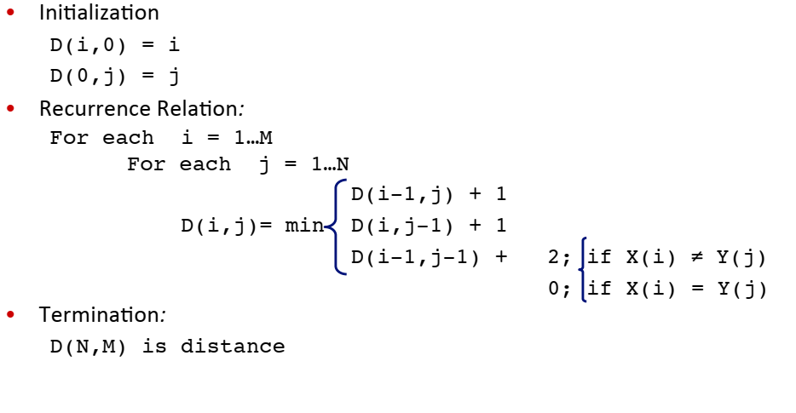
MED computation

Slide 9
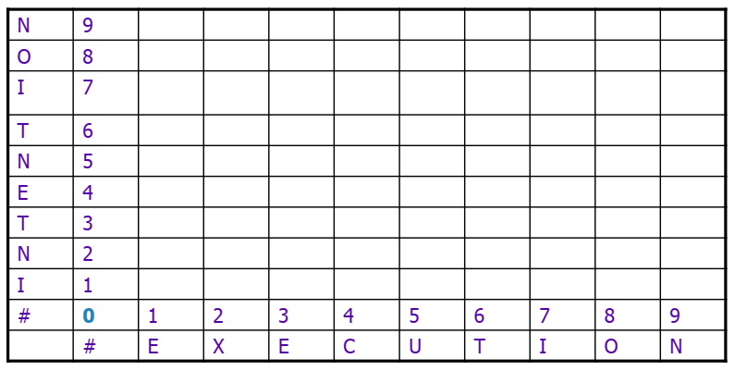
Edit distance table

Slide 10
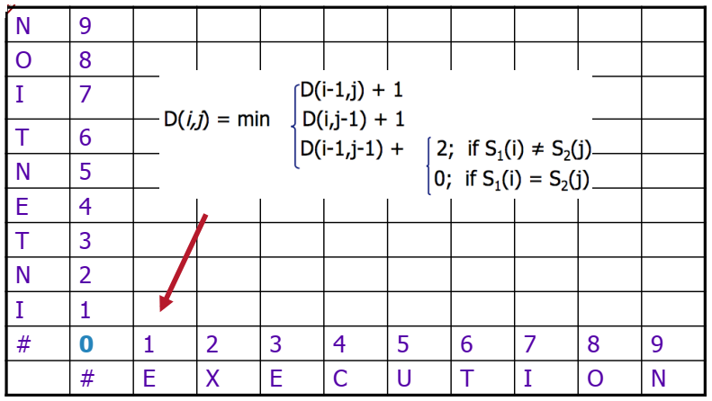
Edit distance table

Slide 11
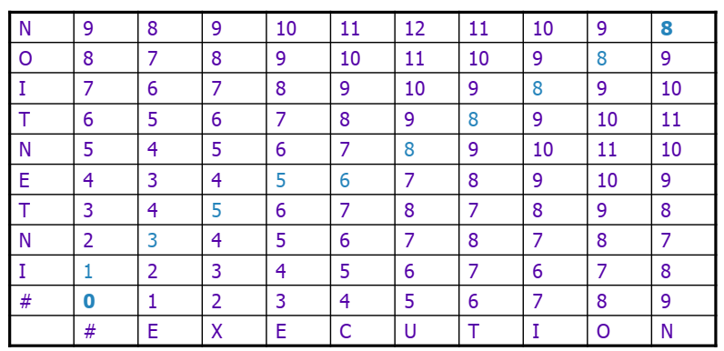
Edit distance table

Slide 12
Computing alignments
Edit distance isn’t sufficient: we often need to align each character of the two strings to each other.
We do this by keeping a “backtrace”.
Every time we enter a cell, remember where we came from. • When we reach the end, trace back the path from the upper right corner to read off the
alignment

Slide 13
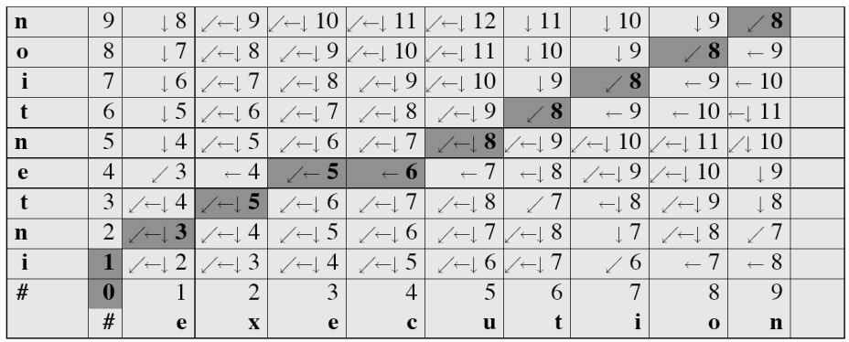
MED with BACKTRACE

Slide 14
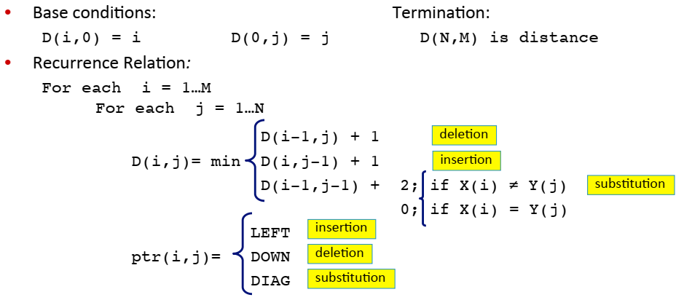
MED+BACKTRACE

Slide 15
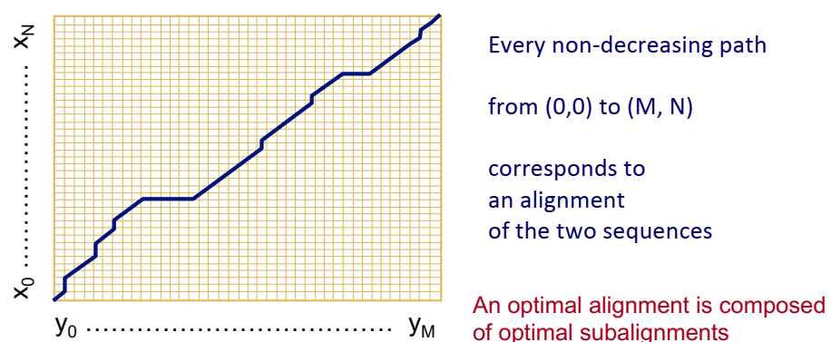
Distance Matrix

Slide 16
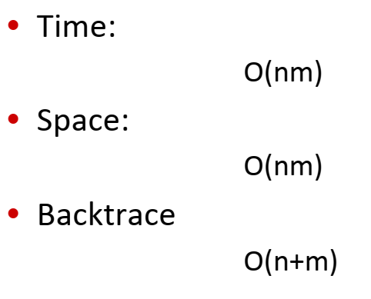
Performance

Slide 17
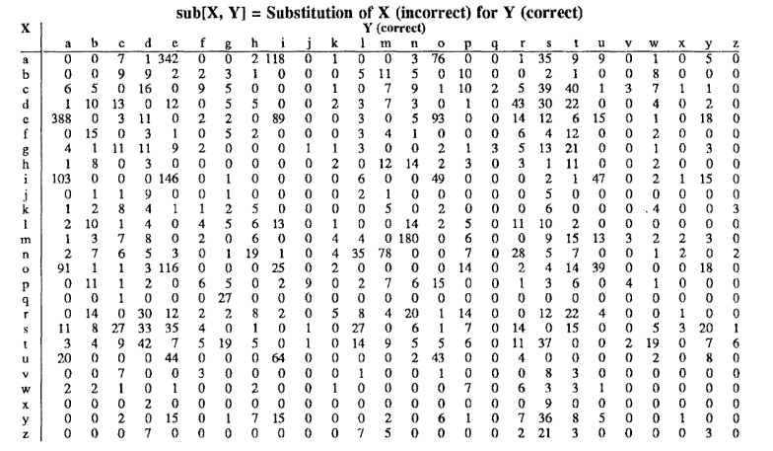
Weighted MED
Some errors are more frequent than others.
Confusion matrix for spelling errors

Slide 18
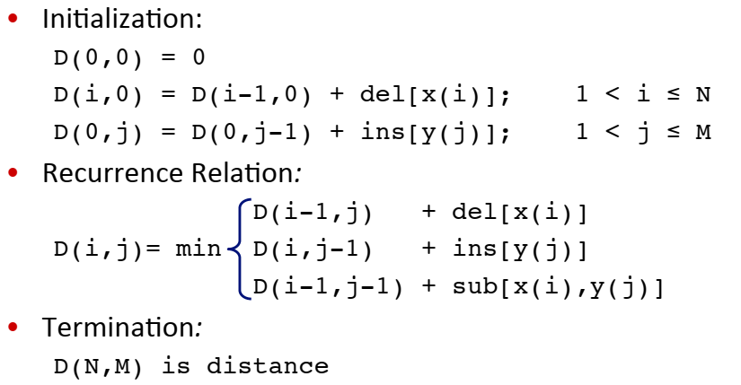
Weighted MED

